Slide 1

UAVs on ugv pursuit
A.Y. 2021/22 - Robotics and Control 2 Final project
Group 11 - Ambrosin Gioele, Andreoli Jacopo, Pastorello Edoardo

Slide 2
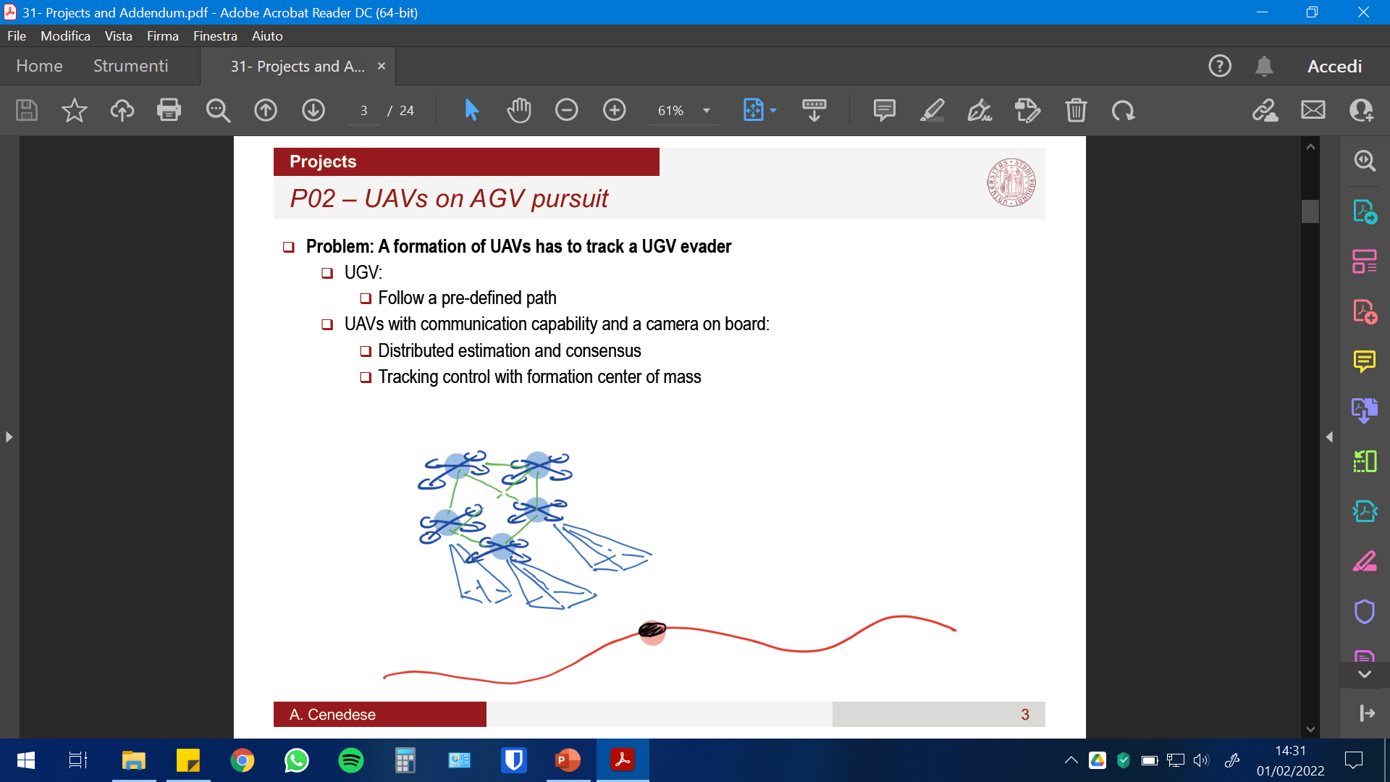
Summary
Introduction to the problem, applications and proposed solution
Full description of project, methods and assumptions
Simulink models, controllers and test trajectories
Consensus on the UAV network
Camera model and pose reconstruction
Consensus on camera measurements
Generation of UAV trajectories
Extra (Communications, faults, etc.)
Results and issues
Future developments

Slide 3
Introduction and motivation
Problem: A formation of UAVs has to track a UGV evader, that is following its own trajectory
Each UAV is provided with a camera to retrieve its relative position wrt the UGV
Consensus used for:
Formation control
UGV motion estimation
Applicable whenever an independent agent has to be followed: motion picture industry, security…

Slide 4
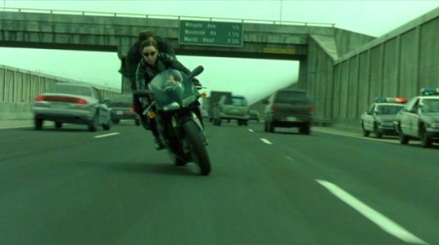
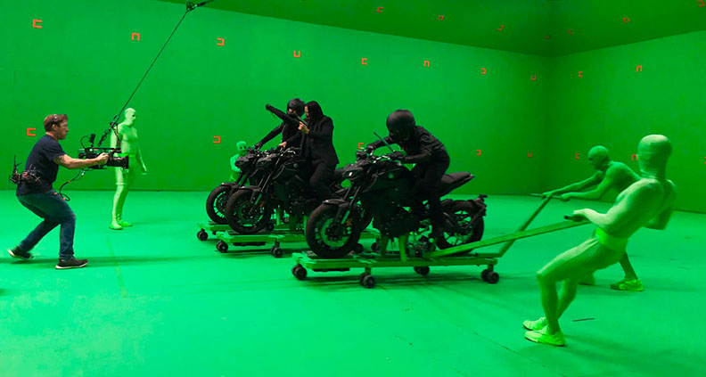
Applications 1/2
Cinema: how to recreate a car chase (or car spots)?
Green screen – CGI
Driven vehicles with staff on board – not safe
Our solution: markers (removable) + automatic drones for multiple framing

Slide 5
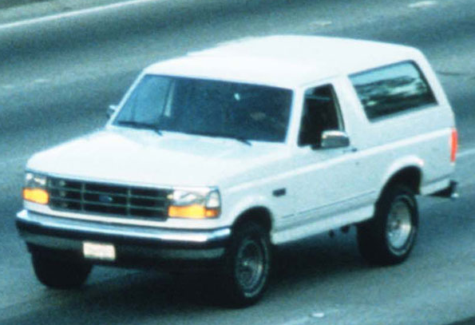
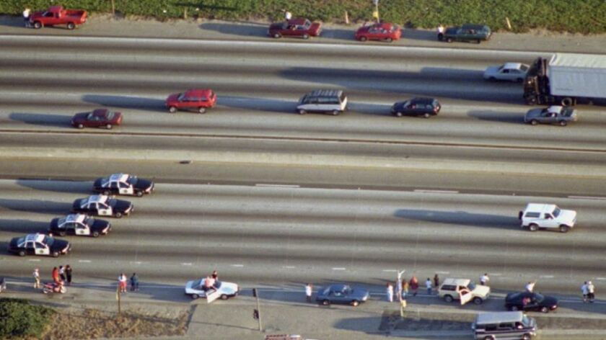
Applications 2/2
Security: police chase (need for high performance drones)
Need additional feature extraction and learning techniques for agent recognition

Slide 6
Proposed solution
Leader following strategy only for orientation (leader kept in front of UGV)
At least 4 markers on the UGV to retrieve relative UAV-UGV position, and keep fixed distance wrt the agent (P4P problem)
Given relative positions, the drones try to maximize their relative distances wrt the 2 neighboring drones (no one knows how many drones are there -> Consensus). All info on position given by the camera, not by communications between single drones
After the UGV has moved, each drone estimates the direction of motion -> new consensus for common measurement
Common motion. After N steps, repeat consensus

Slide 7
The project

Slide 8
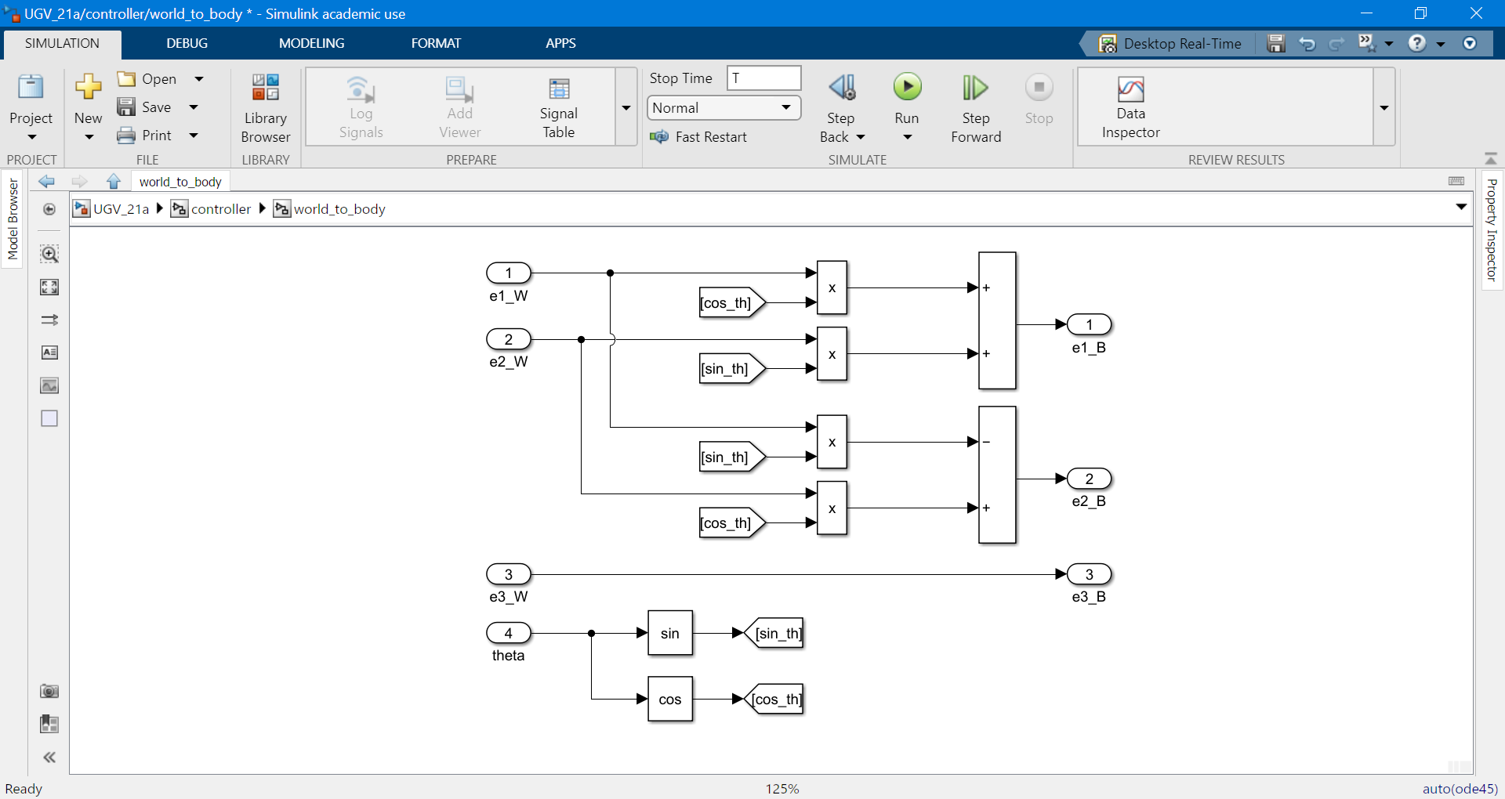
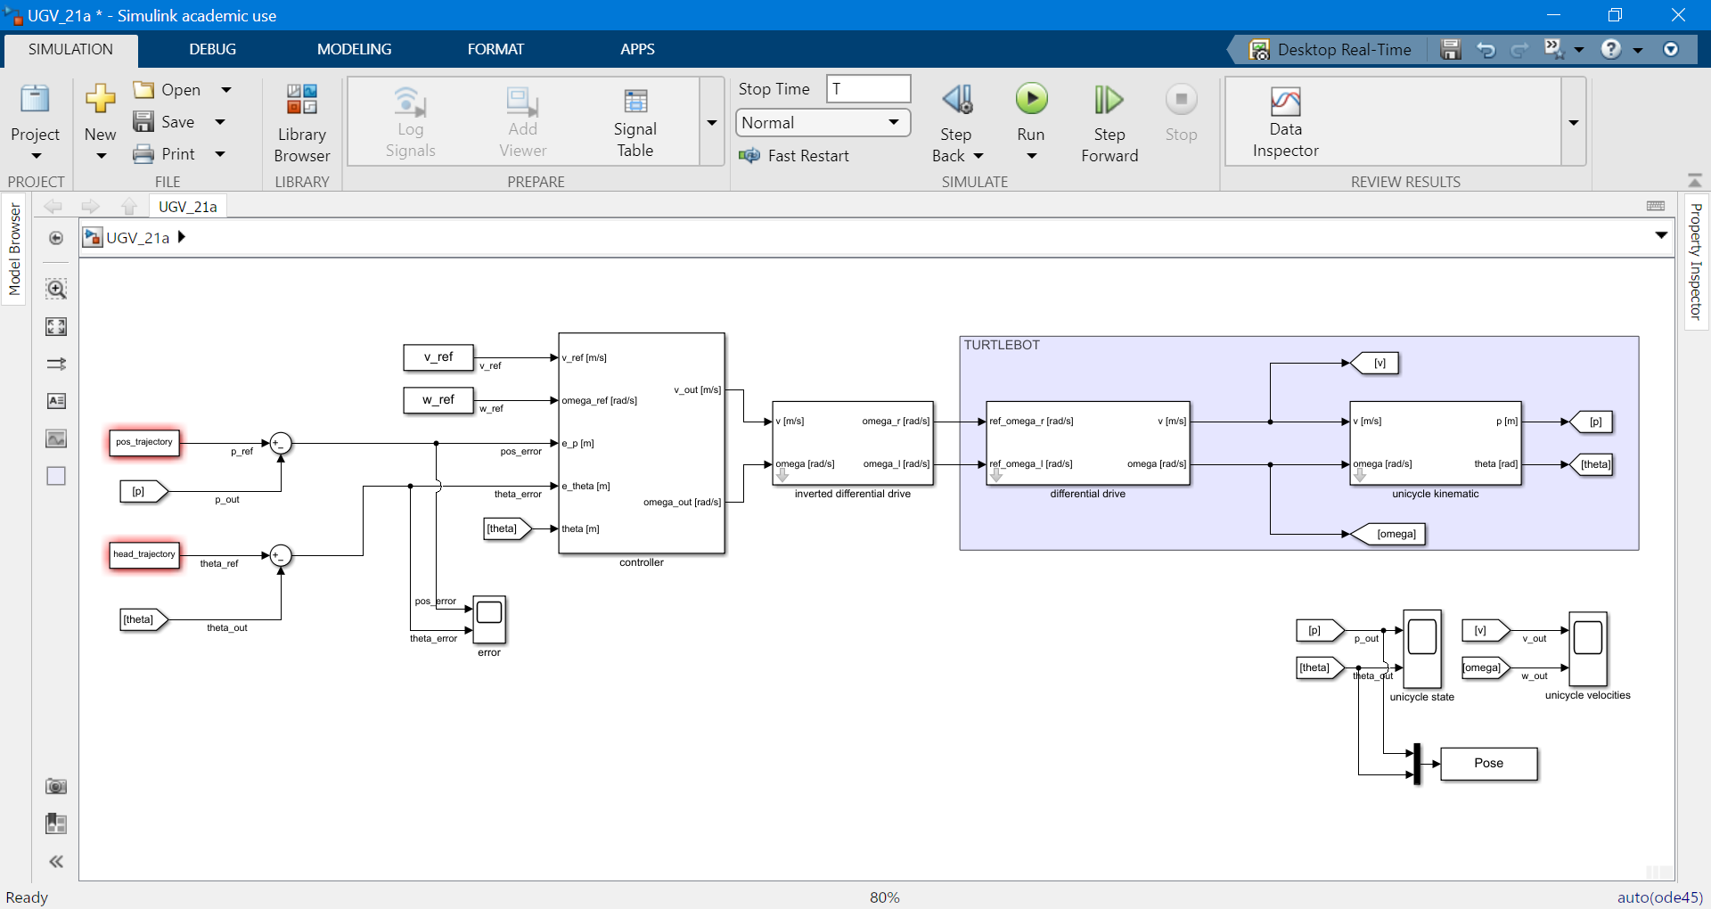
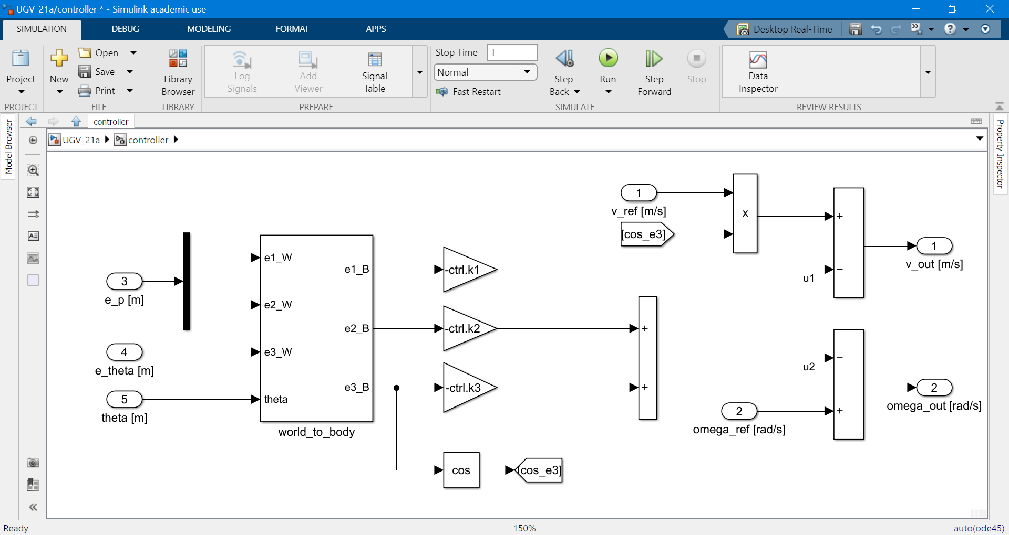
1.a Simulink models (UGV)
Trajectory tracking controller with approximate linearization

Slide 9
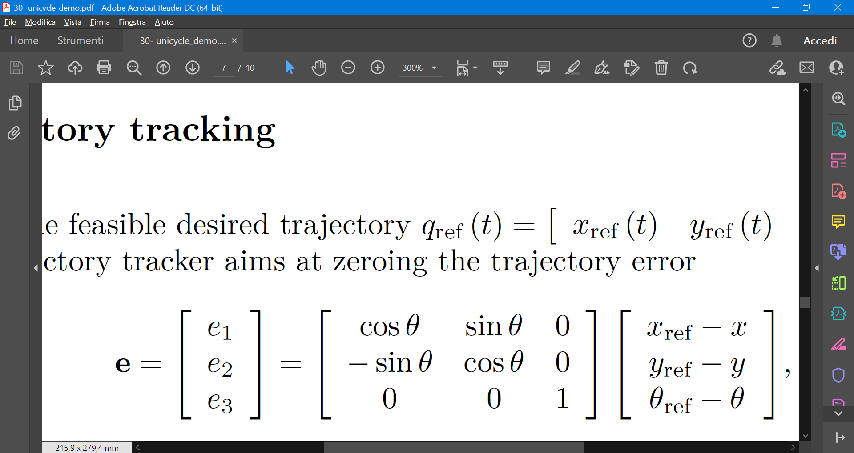
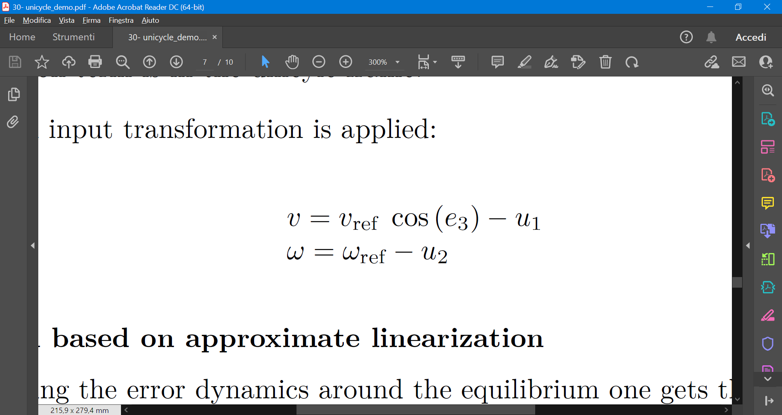
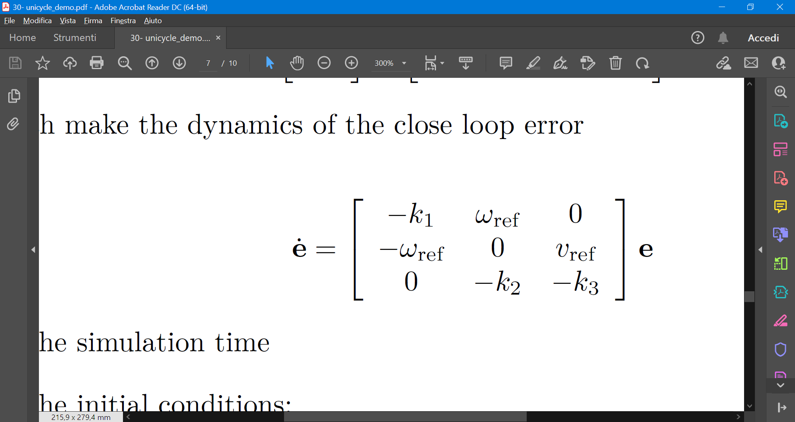
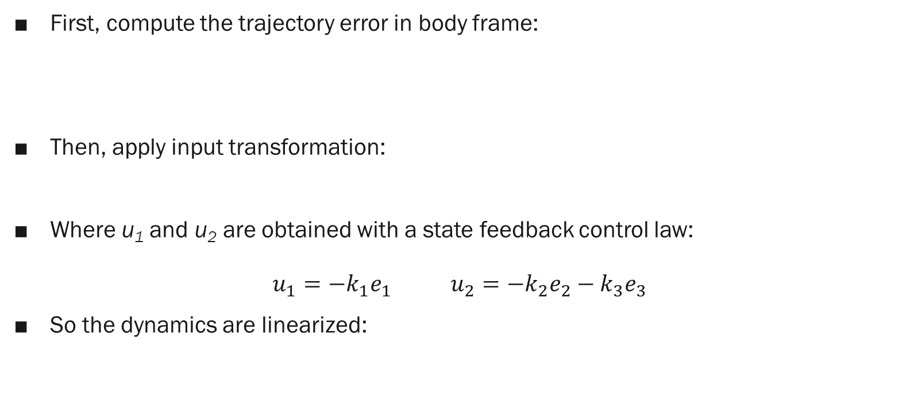
1.a Controllers and trajectories (UGV) 1/2
First, compute the trajectory error in body frame:
Then, apply input transformation:
Where u₁ and u₂ are obtained with a state feedback control law: $u_{1}=−k_{1}e_{1}$ $u_{2}=−k_{2}e_{2}−k_{3}e_{3}$
So the dynamics are linearized:

Slide 10
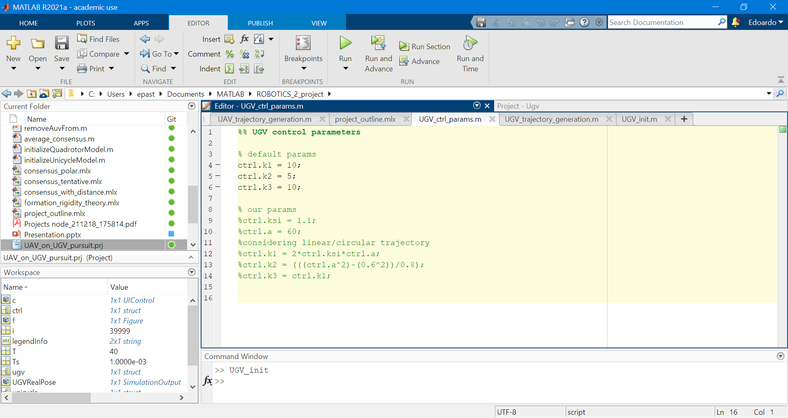
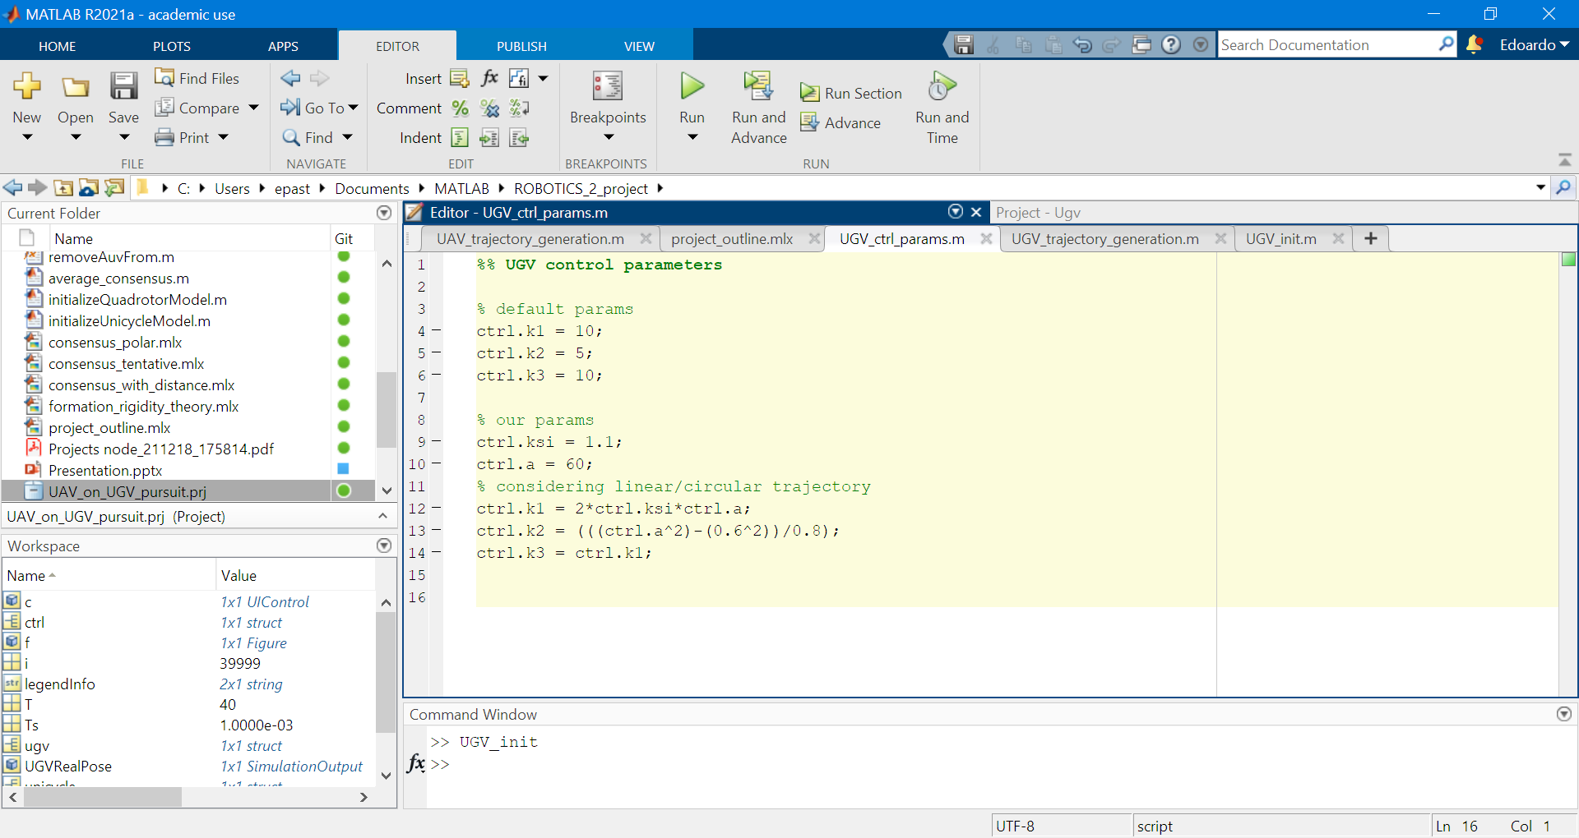
1.a Controllers and trajectories (UGV) 2/2
The control parameters seen in class have been used:
Good results also with eigenvalues allocation rule studied during the lectures:

Slide 11
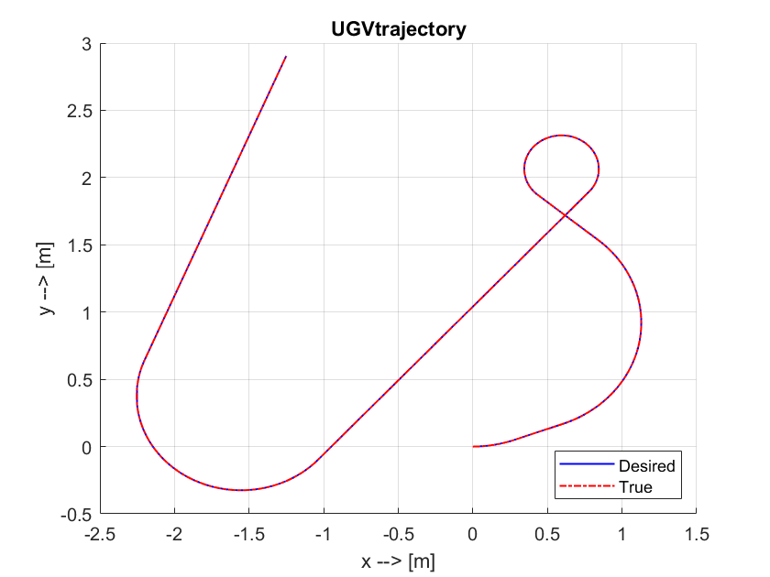
1.a Controllers and trajectories (UGV) 2/2
More details on MATLAB file:
trajectories_and_controllers/UGV_init.m
40 s
The control parameters seen in class have been used:
Good results also with eigenvalues allocation rule studied during the lectures:
Maximum speed (0.36 m/s)
start

Slide 12
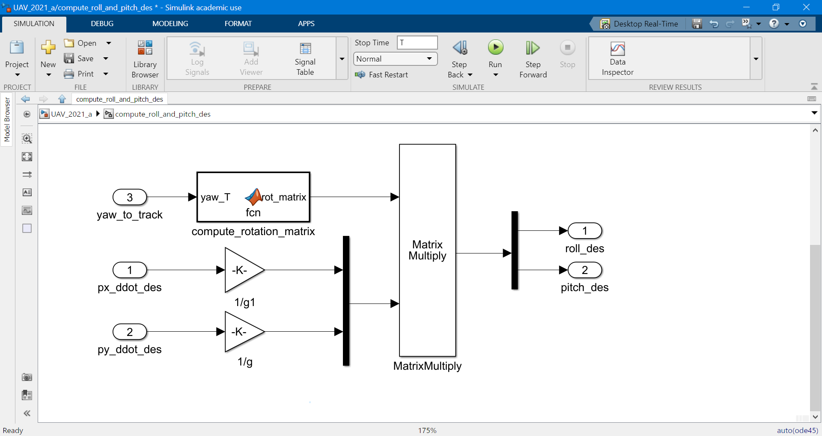
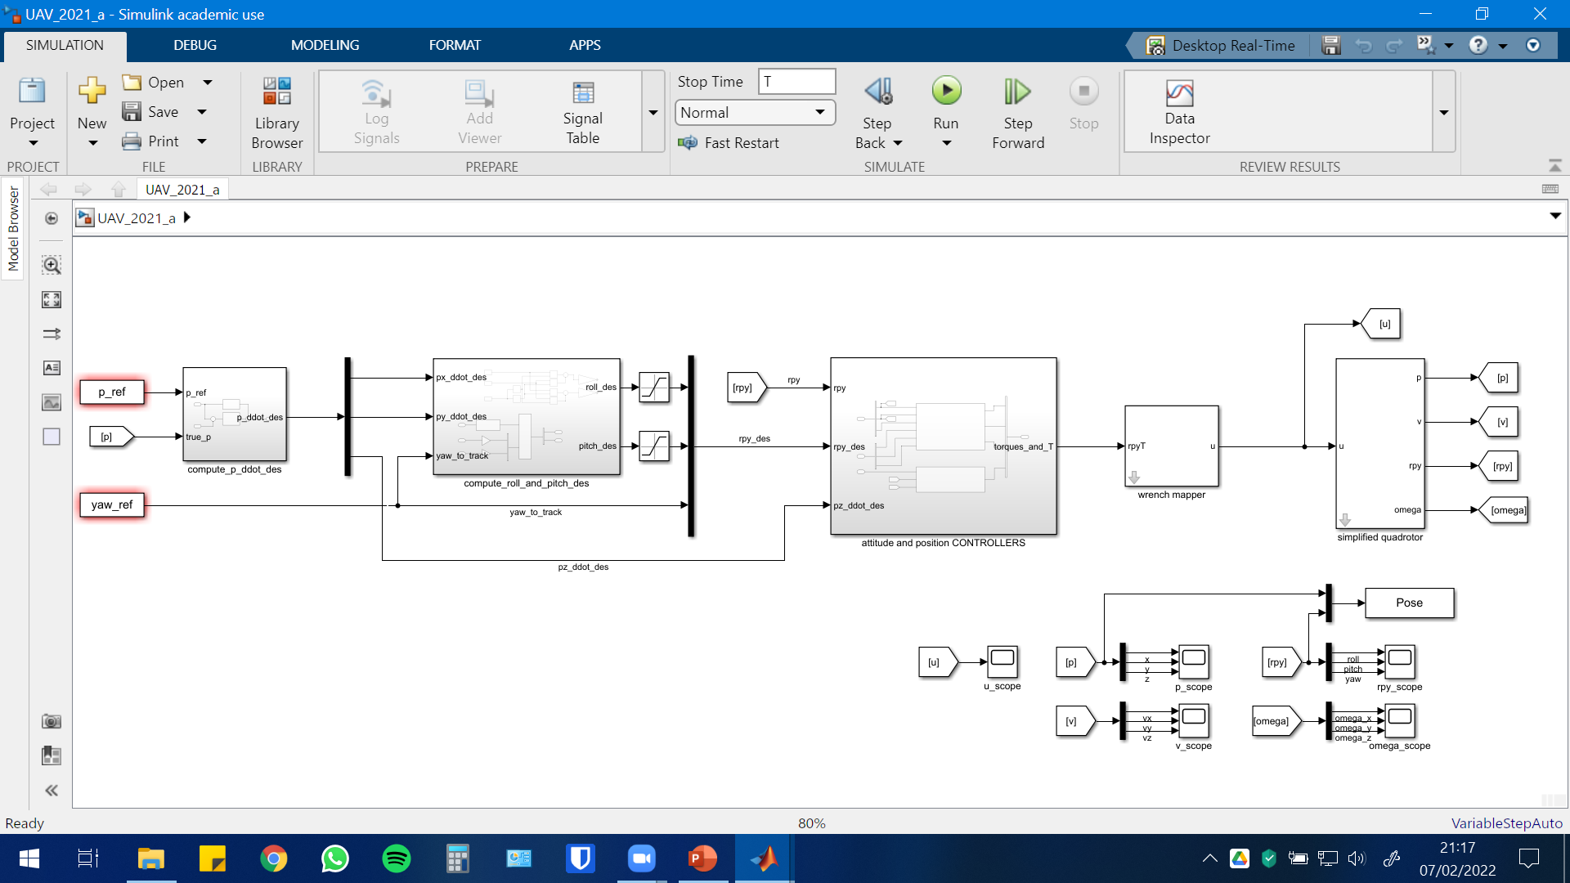
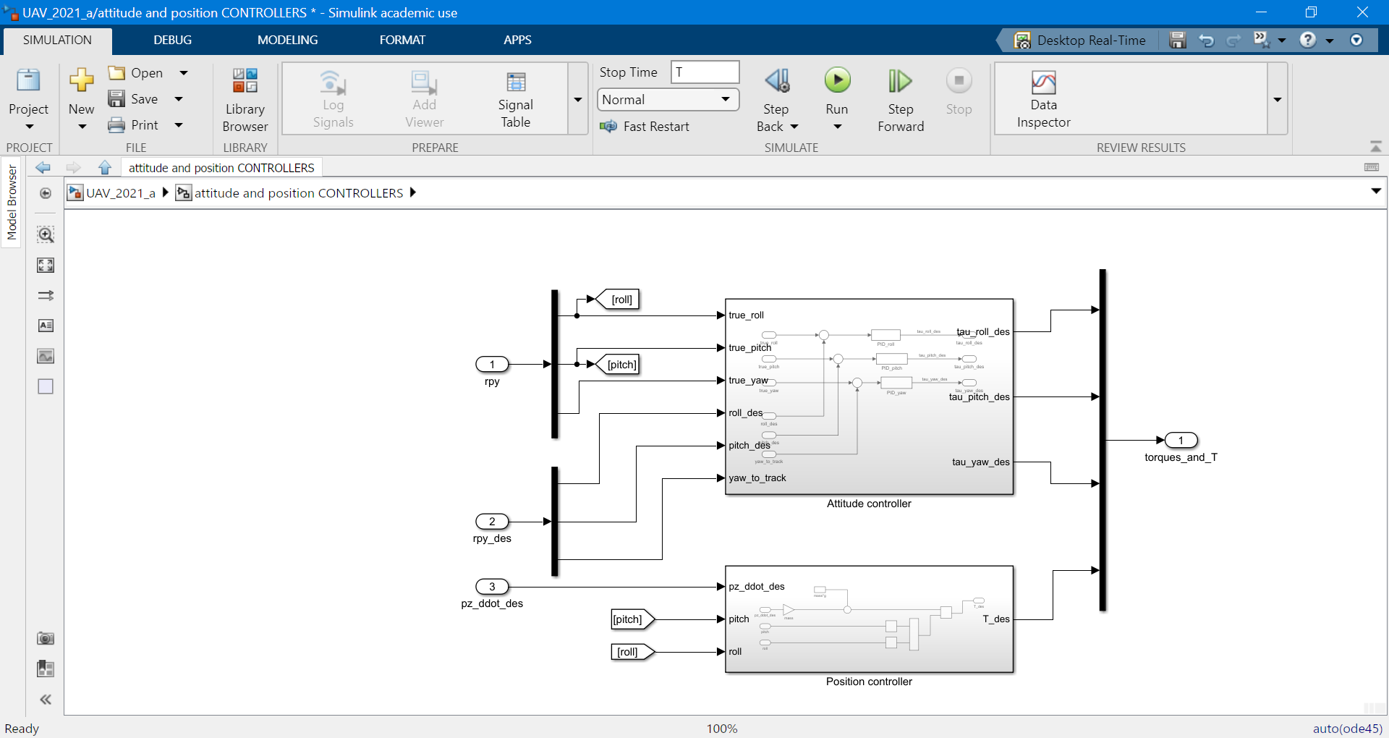
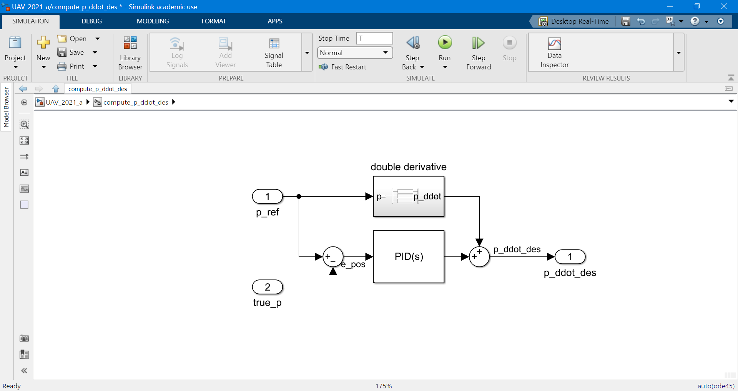
1.b Simulink models (UAV)
Position+attitude controller (x,y,z and yaw angle to track)

Slide 13
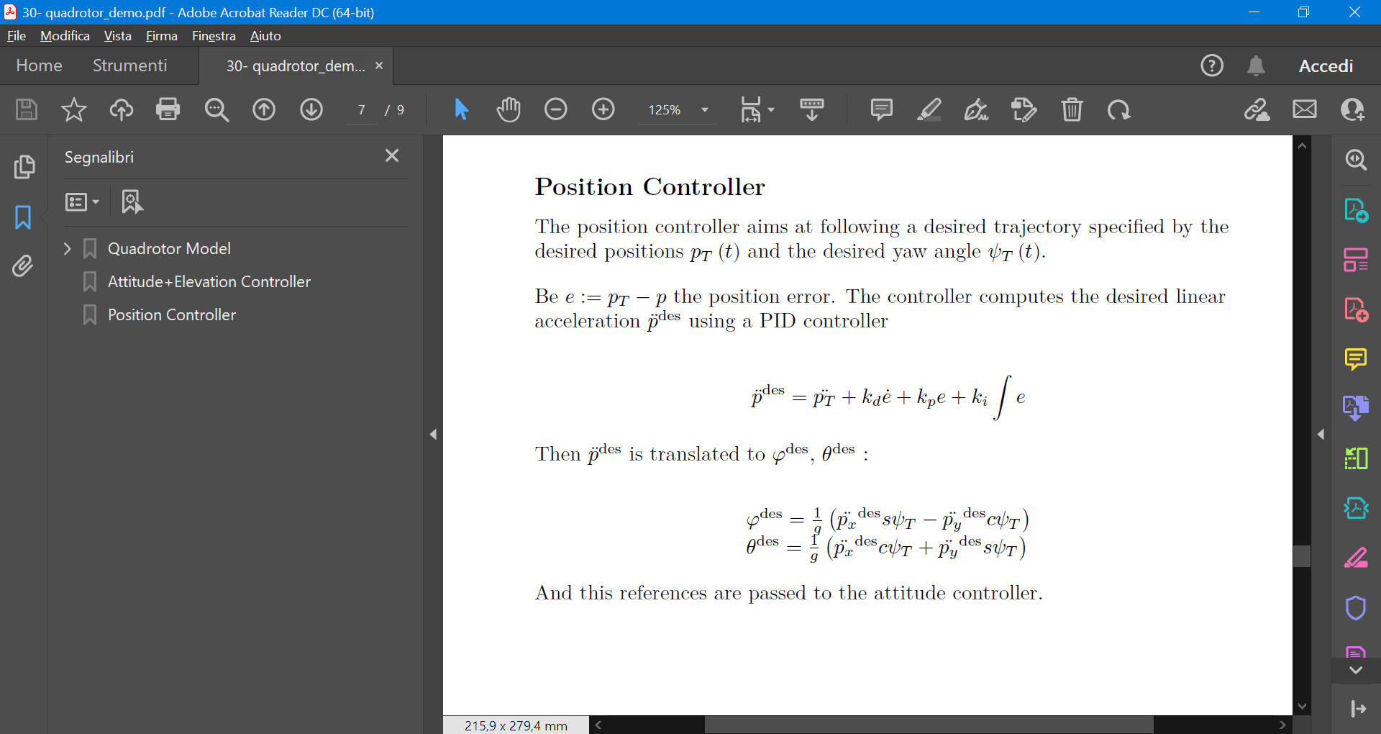
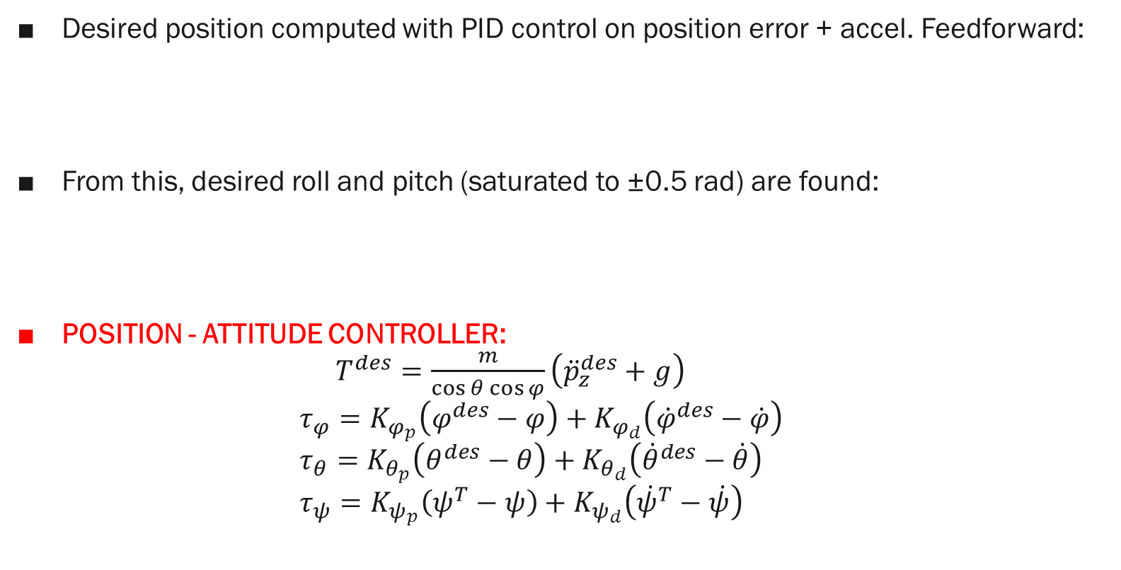
1.b Controllers and trajectories (UAV) 1/3
Desired position computed with PID control on position error + accel. Feedforward:
From this, desired roll and pitch (saturated to ±0.5 rad) are found:
POSITION - ATTITUDE CONTROLLER: $T^{des}=\frac{m}{\cos{θ\cos{φ}}}\left({\ddot{p}}_{z}^{des}+g\right)$ $τ_{φ}=K_{φ_{p}}\left(φ^{des}−φ\right)+K_{φ_{d}}\left({\dot{φ}}^{des}−\dot{φ}\right)$ $τ_{θ}=K_{θ_{p}}\left(θ^{des}−θ\right)+K_{θ_{d}}\left({\dot{θ}}^{des}−\dot{θ}\right)$ $τ_{ψ}=K_{ψ_{p}}\left(ψ^{T}−ψ\right)+K_{ψ_{d}}\left({\dot{ψ}}^{T}−\dot{ψ}\right)$

Slide 14
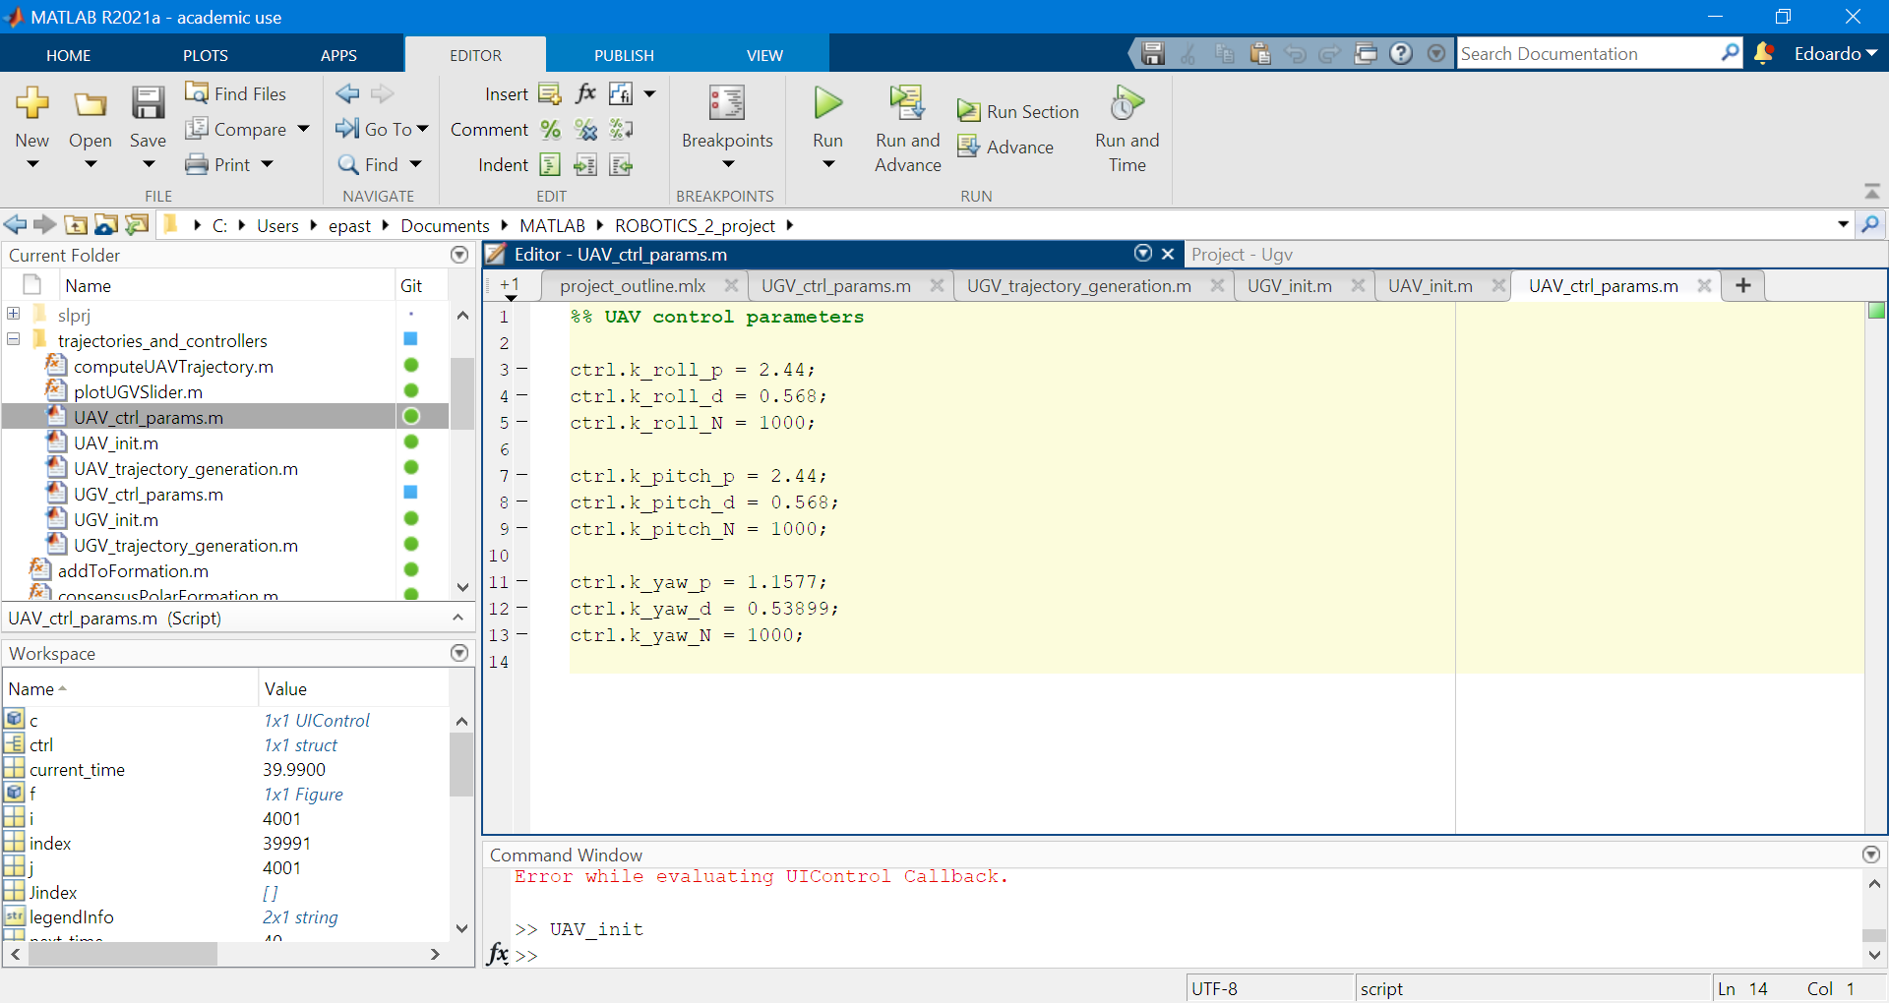
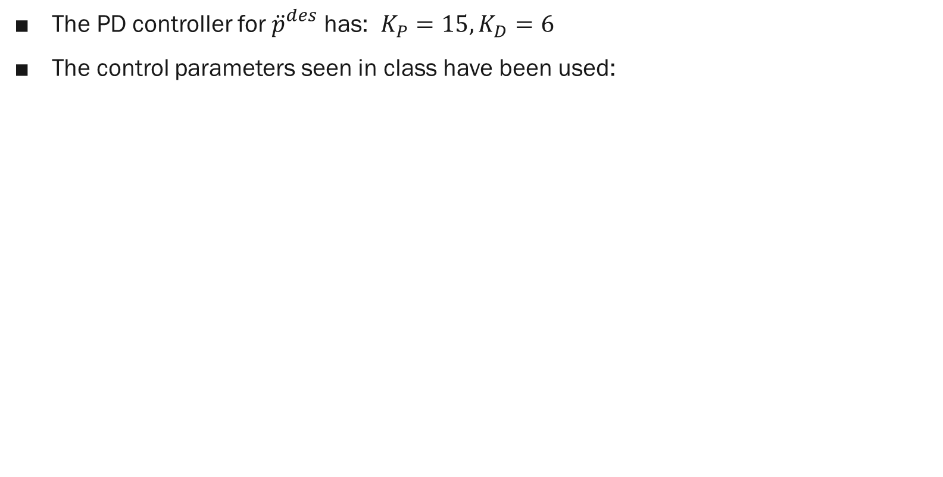
1.b Controllers and trajectories (UAV) 2/3
The PD controller for ${\ddot{p}}_{}^{des}$ has: $K_{P}=15, K_{D}=6$
The control parameters seen in class have been used:

Slide 15
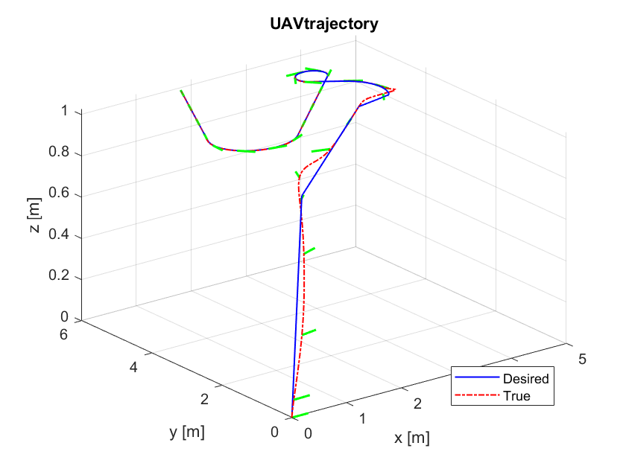
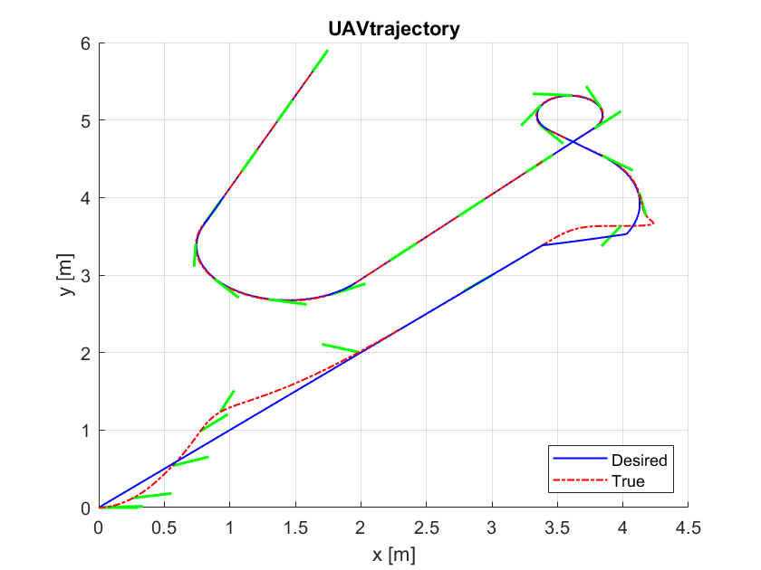
1.b Controllers and trajectories (UAV) 3/3
To validate the controller, the same trajectory of the UGV was used: the output of the simulation was given to a function computeUAVTrajectory(Pose,NextPose,time)
This function is meant to take two poses and a time interval, and generates a feasible trajectory (1 point each 1 ms)
A convex combination is exploited to this end (motion linear and uniform)
Note: additional offset

Slide 16
2. Consensus
testo

Slide 17
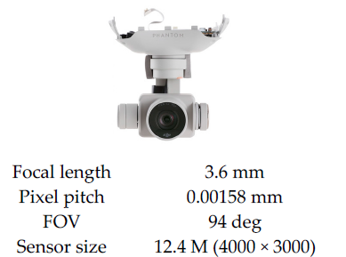
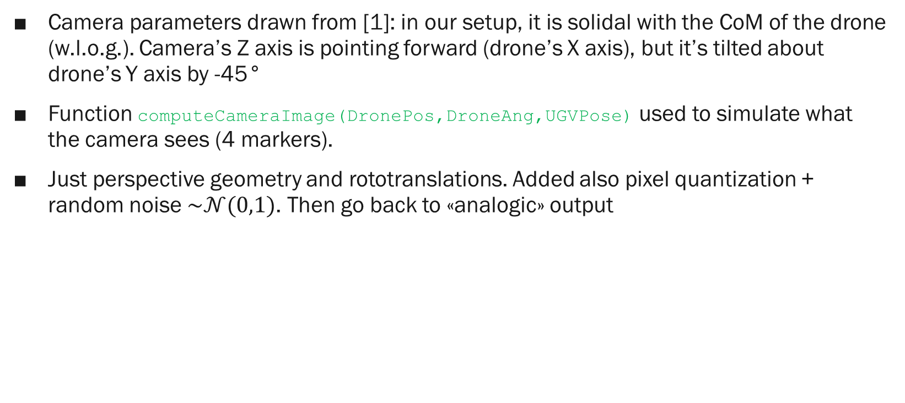
3.a Camera model 1/2
Camera parameters drawn from [1]: in our setup, it is solidal with the CoM of the drone (w.l.o.g.). Camera’s Z axis is pointing forward (drone’s X axis), but it’s tilted about drone’s Y axis by -45°
Function computeCameraImage(DronePos,DroneAng,UGVPose) used to simulate what the camera sees (4 markers).
Just perspective geometry and rototranslations. Added also pixel quantization + random noise $\sim 𝒩(0,1)$. Then go back to «analogic» output
z
y
x
z
[1] Oh, J.; Lee, C. 3D Power Line Extraction from Multiple Aerial Images. Sensors 2017, 17, 2244. https://doi.org/10.3390/s17102244

Slide 18
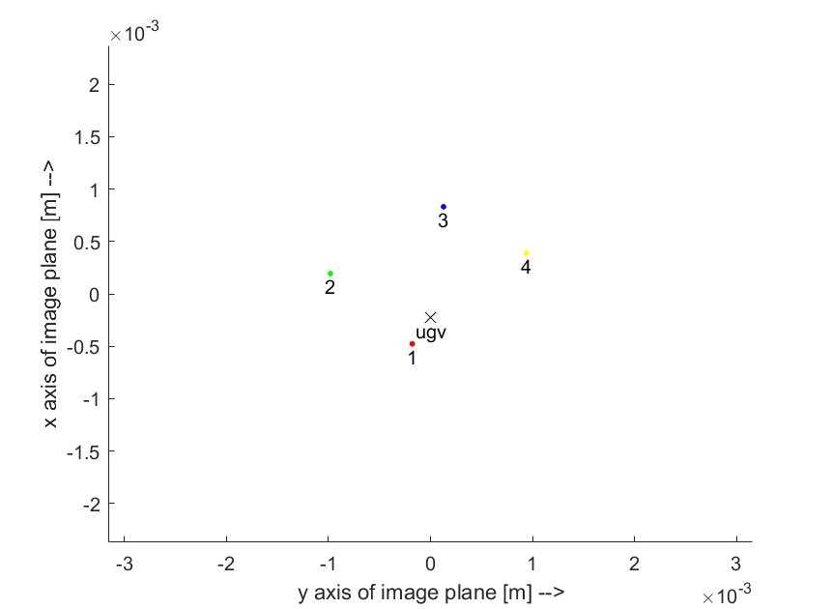
3.a Camera model 2/2
Drone at [0.5 m 0.5 m 0.8 m] wrt UGV, yaw=225°
15 cm
ugv
ugv
20 cm
20 cm

Slide 19
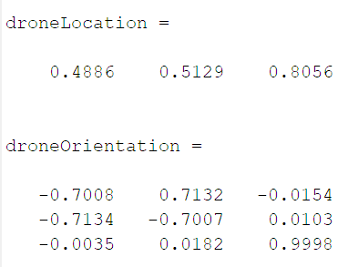

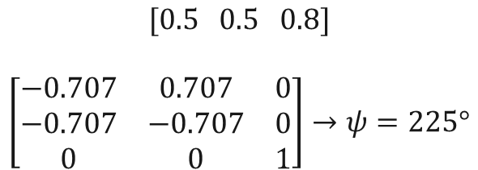
3.b Pose reconstruction
Function PoseReconstruction(ImagePoints) used to retrieve the pose of the UAV wrt the UGV frame
It makes use of MATLAB built-in function estimateWorldCameraPose to solve the P4P problem (better than our hand-made function)
Regarding the previous example:
$$[0.5 0.5 0.8]$$
$$\left[\begin{matrix}−0.707 & 0.707 & 0 \\ −0.707 & −0.707 & 0 \\ 0 & 0 & 1\end{matrix}\right]→ψ=225°$$
$$\sim$$

Slide 20
4. Consensus on measurements
testo

Slide 21
5. Generation of trajectories (UAV)
testo

Slide 22
6. Extra
testo

Slide 23
Results and issues

Slide 24
Results
testo

Slide 25
Issues
testo

Slide 26
Future developments

Slide 27
Further development
testo

Slide 28
Thank you

